Slide 1
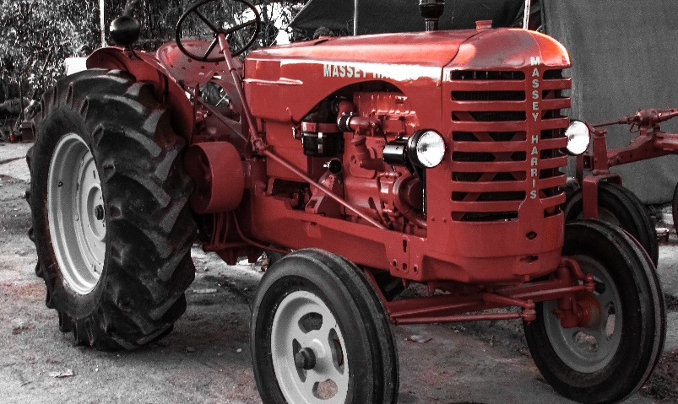
Carl Moyer Grant Program Public Workshop
The Workshop will start at 2:00 PM
Hosted by the Feather River Air Quality Management District
Thursday February 6, 2025

Slide 2
Agenda
Welcome & Introductions
Public Workshop to Be Recorded and Posted to Website
What is the Carl Moyer Program
What is the FARMER Program
Program Overview
Regulatory Compliance
Four Main Project Categories
Other Project Types
Resources and Contact Information
Question/Answers

Slide 3
Carl Moyer Memorial Air Quality Standards Attainment Program

Slide 4
Carl Moyer Memorial Air Quality Standards Attainment Program
Since 1998 Carl Moyer Program has provided incentive grants for cleaner-than-required engines and equipment throughout California
The program seeks to reduce emissions of oxides of nitrogen (NOx), particulate matter (PM), and reactive organic gas (ROG) which are necessary for California to meet its clean air commitments under the State Implementation Plan
Public and private entities can apply
Eligible projects include replacement, repower, or retrofit of off-road equipment used in construction, agriculture, mining, and stationary irrigation pump engines
CARB’s 2024 Carl Moyer Guidelines
District Policy and Procedures Manual
Projects are subject to oversight and audit by FRAQMD, CARB, DOF

Slide 5
Funding Agricultural Replacement Measures for Emission Reductions Program

Slide 6
FARMER Program
Funding Agricultural Measures for Emission Reductions Program
Supported by California Climate Investments, a statewide program that puts billions of Cap-and-Trade dollars to work reducing greenhouse gas emissions, strengthening the economy, and improving public health and the environment – particularly in disadvantaged communities
Year 1, 2, 3, 4, 5, and 6 FARMER Program funding already allocated
Ag trucks were funded under the first two years of FARMER.

Slide 7
Program Overview

Slide 8
General Requirements
Cannot pay for compliance with a regulation
Must be completed before compliance deadline
Old engines/equipment must be operational
If engine hp not known, can calculate based on: Engine HP = PTO x 120 percent
Must operate 75% within California and own for previous 2 years
Cost-Effectiveness will only include equipment usage in Yuba/Sutter counties
Must be cost-effective
Old engine/equipment must be destroyed
Must be approved in program and have signed agreement before purchasing new engine/equipment

Slide 9
Map of Disadvantaged/Low-income Communities
https://webmaps.arb.ca.gov/PriorityPopulations

Slide 10
Funding
Carl Moyer Year 27 award $348,665
FARMER Year 6 funding available approximately $100,000
Award amounts are based on % of cost, not by horsepower
Example: Repower with Tier 4 engine up to 85%; Off-Road Equipment Replacement up to 65%
Maximum funding is $200,000
Eligible for funding: engines/equipment, installation for eligible hardware, transport costs
Ineligible for funding: taxes, extended warranty, maintenance
New engines/equipment purchased must match application; shop around prior to submitting Application
Equipment change requests will only be allowed if the original equipment is no longer manufactured, if the dealer closed, or some other factor out of the applicant’s control

Slide 11
Project Selection
Only one application per person/business/entity/farm
Applications will be reviewed for completeness; completeness notification mailed or emailed
All complete Applications received by 5:00 pm on Monday March 24, 2025, will be entered into random draw
Incomplete Applications will not be entered into draw
If selected by random draw, project will be evaluated for cost-effectiveness and eligibility
Tier 2 to Tier 4 replacement projects will be entered into random draw after Tier 0 to Tier 4 replacement projects, Tier 1 tier to tier 4 replacement projects, ZE UTV replacement projects, and repower projects are funded

Slide 12
Determining Cost-Effectiveness
The most C/E project achieves the largest emission reductions for the least amount of funding
Factors involved in C/E calculation:
Emissions of old engine Number of years under contract (project life)
Emissions of new engine Cost of new engine/equipment
Hours per year engine is operated
Cost-Effectiveness ($/ton) = grant amount ($) x CRF
annual weighted surplus emission reductions
CRF: Capital recovery factor
Annual Weighted Surplus Emission Reductions (tons/Yr) = NOx Reductions + ROG Reductions + (20 x PM reductions)
Weighted surplus emission reductions include deterioration products and adjustment factors
Cost-Effectiveness will be calculated by District; Detailed instructions are in Carl Moyer Guidelines http://www.arb.ca.gov/msprog/moyer/guidelines/current.htm

Slide 13
Program Timeline and Process
Applications released January 17, 2025
Public Workshop February 6, 2025
Zoom Drop-in meetings for Q&As once per week before the due date.
Applications and all additional information due by 5:00 pm on Monday March 24, 2025
Tentative award letters mailed May 2025
Participant accepts award and schedules pre-inspection of existing engine/equipment with District May/June 2025
District and Participant sign Agreement June/July 2025
Participant orders new engine/equipment July 2025
After new engine has been installed and is operational or new equipment has arrived and is ready for delivery to applicant...

Slide 14
Timeline Continued
Schedule post-inspection (should be within 180 days of Agreement signing for replacement/repowers and one year for electric motors)
Destroy old engine/equipment
Submit W-9 tax form and invoices
Payment will be issued to Participant
1099 issued for year payment was received
First annual report mailed out year after project completion, and then every year throughout life of project (1 to 10 years)
Own/operate engine/equipment per Agreement throughout life of project (1 to 10 years)

Slide 15
Terms of the Agreement
At minimum, applicant is committing to owning and operating the equipment in Yuba and Sutter counties for a number of years
May also have a minimum usage requirement
Must submit annual report
Subject to audit by District and State
If applicant sells equipment without obtaining District approval or fails to achieve minimum usage by the end of the contract a portion of the grant must be repaid
If applicant fails to report annually, fails to respond to audit notice, or other action that District deems subject to termination, the entire grant must be repaid

Slide 16
Destruction of Old Engines/Equipment
Repower projects must destroy old engine
Equipment replacement projects must destroy entire equipment
Existing equipment must be delivered to an approved salvage yard within 60 days of receipt of new equipment (UPDATE)
Existing equipment can be destroyed after signing the contract and before receiving new equipment
Salvage Certification Form will be mailed for replacement projects; bring with the equipment to the salvage yard
List of participating salvage yards will be mailed with Salvage Certification Form

Slide 17
Invoice & Financing Documentation
Dealers provide itemized final invoice
Participant may obtain financing for their portion of the equipment purchase only (>35% plus taxes)
Documentation of financing must be provided to District

Slide 18
Regulatory Compliance & Eligibility Charts

Slide 19
Regulatory Compliance
Ag mobile equipment:
No regulation/compliance deadline for ag off-road mobile
Ag stationary irrigation engines:
Uncontrolled, Tier 1, Tier 2, or Tier 3 engines replaced with a Tier 4 engine or electric motor may be eligible
Diesel must be registered per FRAQMD Rule 4.16
Non-Ag portable and off-road mobile:
Uncontrolled, Tier 1, Tier 2, or Tier 3 engines replaced with a Tier 4 engine or electric motor may be eligible
Off-road mobile - DOORS; portable - PERP or District permit

Slide 20
Off-Road Mobile Eligibility Chart
Equipment Type | Subject to ARB Fleet Rule? | Funding Opportunities¹
Mobile agricultural equipment | No | Engine repowers, retrofits and replacements
Cargo handling equipment at ports/ intermodal rail yards | Cargo Handling Equipment Regulation² | Limited opportunities.
All other equipment (e.g. construction, mining, rental, airport ground support and other industries) | Off-Road Regulation³ | Small fleets: Opportunities exist through Dec. 31, 2025, after which fleet must show 100% compliance with the regulation.
Limited opportunities means a fleet’s compliance status with the ARB regulation must be determined. Contact air district Moyer Program staff or consult fleet rule Carl Moyer Implementation Charts at: http://www.arb.ca.gov/msprog/moyer/guidelines/supplemental-docs.htm in addition to the Guidelines.
Regulation for Mobile Cargo Handling Equipment at Ports and Intermodal Rail Yards: http://www.arb.ca.gov/ports/cargo/cargo.htm
Regulation for In-Use Off-Road Diesel Vehicles http://www.arb.ca.gov/msprog/ordiesel/ordiesel.htm

Slide 21
Diesel Ag Irrigation Engines Eligibility Chart
Tier | HP | Registered As | Compliance Date | Project Type Eligible | Must be installed by
Tier 0, 1, 2 | 25-49 | All | None | Diesel Engine or Electric Motor | N/A
Tier 1 | 50-750 | Intermittent or Low-Use | 2025 | Tier 4 Diesel, SI Electric Motor | December 31, 2025
Tier 2 | 50-750 | Intermittent or Low-Use | 2025 | Tier 4 Diesel, SI Electric Motor | December 31, 2025
Based on compliance deadlines in the Airborne Toxic Control Measure for Stationary Compression Ignition Engines, title 17, California Code of Regulations section 93115 and District Rule 4.16

Slide 22
Portable Non-Ag Diesel Engine Eligibility Chart
Engine Tier | HP | Subject to a Regulation? | Project Type Eligible | Notes
Portable Tier 0, 1, and 2 | 25-49 | No | Repower, Retrofit or Replacement | Engines under 50 horsepower are not subject to the ATCMs and are eligible for Carl Moyer grants
Portable Tier 0 | 50-750 | Yes, Portable ATCM | None | Tier 0 engines subject to Portable ATCM are not eligible for Moyer grants
Portable Tier 1 | 50-750 | Yes, Portable ATCM | None | Tier 1 engines subject to Tier Phase-out Schedule must be retired by 1/1/2020, thus not eligible for Carl Moyer grants
Portable Tier 2 | 50-750 | Yes, Portable ATCM | Tier 4 diesel or SI repowers and replacements | Small and Large Fleet funding opportunities possible
Based on compliance deadlines in the Portable Engine Airborne Toxic Control Measure, Title 17 CCR 93116 http://www.arb.ca.gov/diesel/peatcm/peatcm.htm

Slide 23
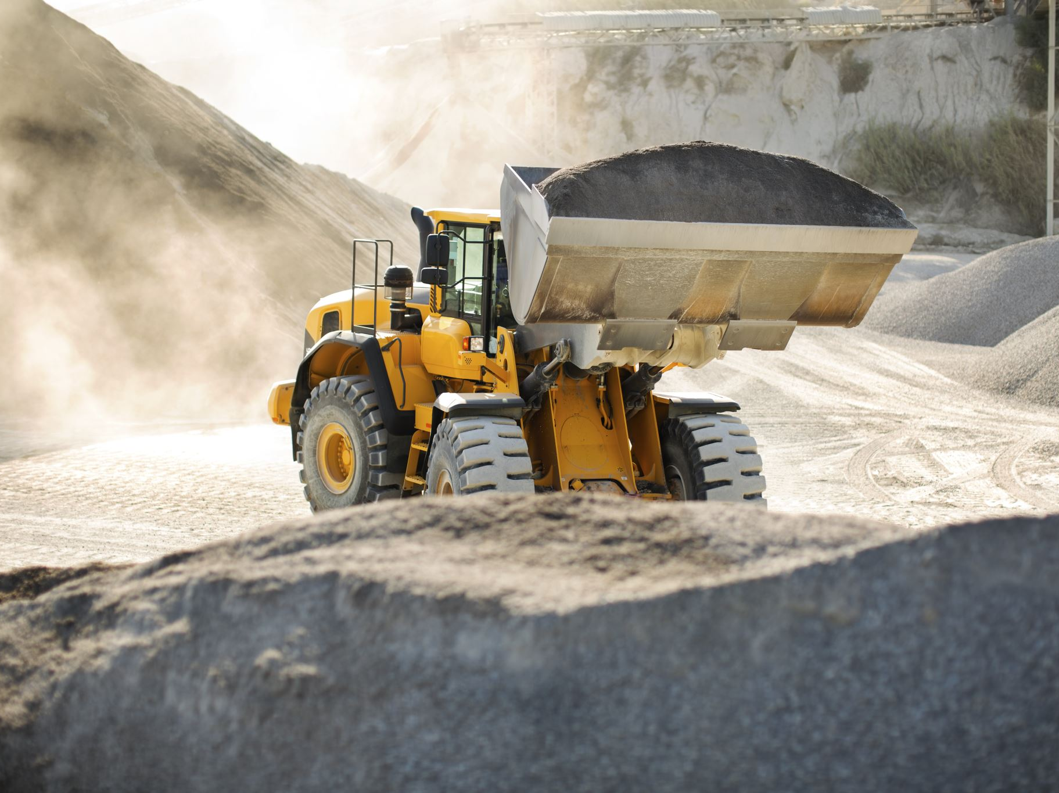
Project Categories

Slide 24
Project Types - Overview
Four Applications:
Ag Pump Repower & Electrify
Off-Road Repower & Retrofit
Off-Road Equipment Replacement
Zero-Emission UTV
Eligible equipment can be used in construction, agriculture, government, & other business
Examples:
Agricultural irrigation pumps = Ag Pump Repower Application
Repowering engine on agricultural bin carriers = Off Road Repower Application
Replacing old off-road tractor with tractor = Off Road Equipment Replacement Application
Replacing diesel UTV with electric UTV = Zero-Emission UTV Application

Slide 25
Project Type Descriptions
Repower – the replacement of the existing engine with a newer emission-certified engine or electric motor
Retrofit – the installation of an ARB verified emission control system on an existing engine
Equipment Replacement – the purchase of new or used equipment with an engine certified to the current emission standard to replace older equipment that must be scrapped

Slide 26
Ag Pump Repower & Electrify

Slide 27
Ag Pump Repower & Electrify
Repower awards up to 85% of the cost of the project
Diesel to diesel, SI, or electric
SI to SI or electric
Project life between 1-10 years
Low-use and Intermittent Tier 1/2 must be completed by 12/31/2025
Required to Apply:
Proof of liability insurance
Quote for new engine/motor (any dealer)
Executive order for new engine
Complete application

Slide 28
Off-Road Repower and Retrofit

Slide 29
Required to Apply
Completed Application
Proof of liability insurance for property on Application
Itemized quote for new engine/motor
Can use any certified dealer/installer
Executive order for new engine
24 months of historical usage (optional)
If not provided, estimate usage on Application and the project will be required to meet a minimum usage
Regulatory compliance (DOORS, PERP) if applicable
Co-funding information (if applicable)
Zero emission repowers (except stationary ag) must have 3 year or 5,000 hour warranty

Slide 30
Off-Road Equipment Replacement

Slide 31
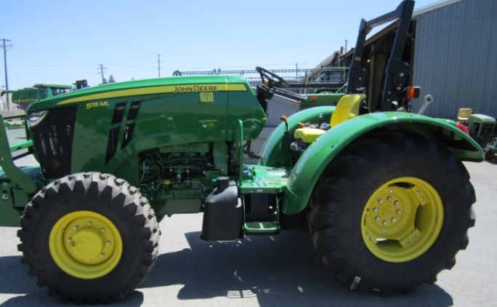
Replacement Projects
One piece of off-road equipment can be replaced by one piece of new or used off-road equipment
Old equipment must be Tier 0 (Generally older than 1996), Tier 1, or Tier 2
Grant will pay up to 65% of the cost of the new equipment
Project life between 3-10 years
Replacement equipment must serve same function as old equipment (tractor for tractor, forklift for forklift)
The cost of a cab or loader may be included in the grant amount if the original equipment has a cab or loader
If original equipment lacks a cab or loader applicant can cover entire cost of additional equipment

Slide 32
Horsepower Increase Option
Existing ORERP program
New equipment’s engine hp cannot be greater than 135% of the original engine’s hp.
Unlimited reduction in hp allowed.
If no equivalent new equipment that is within 135% of the original equipment’s horsepower, can apply for higher hp with statement from manufacturer.
HP Increase Option (added in last year’s program)
ORERP projects CAN apply for engine hp that is greater than 125% of the original equipment’s horsepower EVEN IF there is an equivalent new equipment within 135% of the original equipment’s horsepower.
Applicant must fill out and complete the NEW supplemental form for the higher horsepower equipment.
The grant award amount will be based on the new equipment with hp within 135% of the original engine hp.
Emissions reductions used to calculate cost effectiveness will be based on the higher horsepower equipment.

Slide 33
Required to Apply
Completed application
Evidence of liability coverage
Hour meter photograph
Usage data
Proof of ownership
Proof of operational status
Replacement engine Executive Order (from dealer) http://www.arb.ca.gov/msprog/offroad/cert/cert.php
Replacement equipment price quote and spec sheet (from dealer)
Warranty documents (from dealer)

Slide 34
Required to Apply Part 2
Copy of liability insurance for business/farm
Does not need to list FRAQMD
Must match address on application
Photograph of hour meter
Does not have to be working
Please include written statement.

Slide 35
Annual Hourly Usage Is Required
Cost-effectiveness must be based on hours of operation
Provide two years of annual usage on application and attach documentation showing how usage was estimated
Documentation could include employee time sheets linked to equipment usage, equipment service records with copies of receipts of supplies purchased, operational records, repair work orders from third party that provide a date and hour meter reading
The best records are dated, and hour meter readings can be verified through additional third-party documentation.
If you do not have a working hour meter or no hour meter installed, a written statement of how the hours are calculated is helpful. Forecast equipment usage conservatively if you do not have timesheet records.

Slide 36
Proof of Existing Ownership
Copy of the Bill of Sale for old equipment from dealership/auction/or notarized private party OR
Provide documentation for previous two years that specifically lists the equipment such as:
Tax depreciation logs
Property tax records
Bank appraisals for equipment
Equipment insurance records
Maintenance/service records with copies of receipts for purchase of supplies
General ledgers

Slide 37
Operational Status
Copies of previous year:
Revenue or usage records with operational, standby, and down hours for equipment
Employee time sheets linked to equipment usage
Preventive maintenance records tied to specific usage hours for equipment with copies of receipts for purchase of supplies
Repair work orders from third party specific to equipment

Slide 38
From Participating Dealer Obtain:
Itemized quote
Warranty information
Engine executive order
Must purchase new equipment at District trained/approved dealership
List provided on Application
Not on the list? Call FRAQMD to sign up

Slide 39
Required Warranty
Equipment replacement must have a 1 year/1600 hour warranty
Used equipment must meet same warranty requirements
Warranty must cover parts and labor
Additional cost for warranty is not eligible for funding

Slide 40
Zero-Emission UTV Replacement

Slide 41
Zero-Emission UTV Replacement Program
One piece of off-road equipment can be replaced by one piece of new zero emission equipment.
The existing vehicle can be an ATV or an UTV. Tractors with less than 25 horsepower are eligible for replacement as well.
Zero-Emission: The vehicle must emit zero tailpipe emissions from its onboard source of power (such as all electric or hydrogen fuel cell vehicles) and may not go under any modification that would allow the propulsion by any other means.
Provide the district with past maintenance records and/or service history on the UTV that is being replaced
Old equipment can be diesel or gasoline fueled.
Old equipment must go through the ORERP process and be scrapped.
ZE UTV Project Category Grant will pay up to 65% of the cost of the new equipment.
Example: If new the equipment costs $18,000 then maximum grant award is $11,700.
In additions to the 65% funding cap, the maximum grant award amount is $13,500.

Slide 42
Required Documentation

Slide 43
ZE UTV Requirements
The vehicle purchased must be a new vehicle.
The Grant Applicant must self certify that the new UTV will be used exclusively for California Agriculture.
The Grant Applicant must not purchase, make payments toward and/or take procession of the new UTV prior to receiving a fully executed grant contract with the District.
New UTVs must have a towing capacity of 500 pounds or greater and a total weight of 700 pounds or greater.
Vehicle drivetrain, including applicable energy storage tanks or battery packs, must be covered by a manufacturer warranty.
Must have a minimum 1-year warranty.
The new UTV must have an operational hour meter installed.
If the during the project life, the hour meter fails for any reason, the hour meter must be repaired or replaced as soon as possible at the owner’s expense.

Slide 44
Other Project Types
Infrastructure in support of off-road equipment
Electrical infrastructure for Ag irrigation motor
Fire apparatus
On-Road Trucks
Ag Trucks-FARMER
Other Trucks-
ARB http://www.arb.ca.gov/msprog/moyer/voucher/voucher.htm
SMAQMD SECAT, Goods Movement (Prop 1B) http://airquality.org/mobile/index.shtml
Other State and Federal programs linked on FRAQMD website https://www.fraqmd.org/links-to-grants-offered-by-other-agencies
Possible loans: http://www.arb.ca.gov/msprog/truckstop/funding/loans_fa.htm

Slide 45
Resources and Contact Information

Slide 46
Resources
District Planning: Department Completing a new Application, updating previous year Application to resubmit, or general program information
District Engineering Department: Diesel Agricultural Engine Registration Program
District Website: Applications, Frequently Asked Questions, Policy and Procedures Manual, ARB Statewide Guidelines
Off-Road Equipment Dealers: Itemized quotes for engines and equipment for repower/retrofit/replacement projects; Executive Orders for engines; warranty information if needed
CARB:1-866-6-Diesel for information on diesel regulations

Slide 47
FRAQMD Program Contacts:
Grant Program Lead – Peter Angelonides (530) 634-7659 ext 209, Pangelonides@fraqmd.org.
Ag Engine Registration Program Lead – William Escobedo (530) 634-7659 ext 212, wescobedo@fraqmd.org.
FRAQMD website – www.fraqmd.org

Slide 48
Thank you for joining us today!
Questions?
Stop recording (it will be posted to website)
Staff to remain online for additional questions

